Slide 1
Types Of Data

Slide 2
Introduction
Today data is everywhere in every field. Whether you are a data scientist, marketer, businessman, data analyst, researcher, or you are in any other profession, you need to play or experiment with raw or structured data.
This data is so important for us that it becomes important to handle and store it properly, without any error.
While working on these data, it is important to know the types of data to process them and get the right results.
There are two types of data: Qualitative and Quantitative data, which are further classified into:

Slide 3
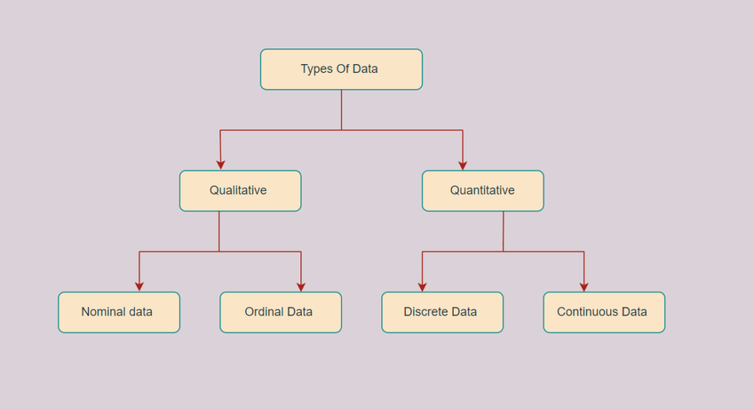
Types of data
The two main types of data are:
Qualitative Data
Quantitative Data

Slide 4
Qualitative or Categorical Data
Qualitative or Categorical Data is a type of data that can’t be measured or counted in the form of numbers.
These types of data are sorted by category, not by number. That’s why it is also known as Categorical Data.
These data consist of audio, images, symbols, or text. The gender of a person, i.e., male, female, or others, is qualitative data.
Qualitative data tells about the perception of people. This data helps market researchers understand the customers’ tastes and then design their ideas and strategies accordingly.
The other examples of qualitative data are :
What language do you speak
Favorite holiday destination
Opinion on something (agree, disagree, or neutral)
Colors
The Qualitative data are further classified into two parts :

Slide 5
A. Nominal Data
Nominal Data is used to label variables without any order or quantitative value. The color of hair can be considered nominal data, as one color can’t be compared with another color.
The name “nominal” comes from the Latin name “nomen,” which means “name.” With the help of nominal data, we can’t do any numerical tasks or can’t give any order to sort the data. These data don’t have any meaningful order; their values are distributed into distinct categories.
Examples of Nominal Data :
Colour of hair (Blonde, red, Brown, Black, etc.)
Marital status (Single, Widowed, Married)
Nationality (Indian, German, American)
Gender (Male, Female, Others)
Eye Color (Black, Brown, etc.)

Slide 6
B. Ordinal Data
Ordinal data have natural ordering where a number is present in some kind of order by their position on the scale. These data are used for observation like customer satisfaction, happiness, etc., but we can’t do any arithmetical tasks on them.
Ordinal data is qualitative data for which their values have some kind of relative position. These kinds of data can be considered “in-between” qualitative and quantitative data.
The ordinal data only shows the sequences and cannot use for statistical analysis.
Examples of Ordinal Data :
When companies ask for feedback, experience, or satisfaction on a scale of 1 to 10
Letter grades in the exam (A, B, C, D, etc.)
Ranking of people in a competition (First, Second, Third, etc.)
Economic Status (High, Medium, and Low)
Education Level (Higher, Secondary, Primary)

Slide 7
Difference between Nominal and Ordinal Data
Nominal Data | Ordinal Data
Nominal data can’t be quantified, neither they have any intrinsic ordering | Ordinal data gives some kind of sequential order by their position on the scale
Nominal data is qualitative data or categorical data | Ordinal data is said to be “in-between” qualitative data and quantitative data
They don’t provide any quantitative value, neither can we perform any arithmetical operation | They provide sequence and can assign numbers to ordinal data but cannot perform the arithmetical operation
Nominal data cannot be used to compare with one another | Ordinal data can help to compare one item with another by ranking or ordering
Examples: Eye color, housing style, gender, hair color, religion, marital status, ethnicity, etc | Examples: Economic status, customer satisfaction, education level, letter grades, etc

Slide 8
2. Quantitative Data
Quantitative data is a type of data that can be expressed in numerical values, making it countable and including statistical data analysis. These kinds of data are also known as Numerical data.
It answers the questions like “how much,” “how many,” and “how often.” For example, the price of a phone, the computer’s ram, the height or weight of a person, etc., falls under quantitative data.
Quantitative data can be used for statistical manipulation. These data can be represented on a wide variety of graphs and charts, such as bar graphs, histograms, scatter plots, boxplots, pie charts, line graphs, etc.
Examples of Quantitative Data :
Height or weight of a person or object
Room Temperature
Scores and Marks (Ex: 59, 80, 60, etc.)
Time
The Quantitative data are further classified into two parts :

Slide 9
A. Discrete Data
The term discrete means distinct or separate. The discrete data contain the values that fall under integers or whole numbers. The total number of students in a class is an example of discrete data. These data can’t be broken into decimal or fraction values.
The discrete data are countable and have finite values; their subdivision is not possible. These data are represented mainly by a bar graph, number line, or frequency table.
Examples of Discrete Data :
Total numbers of students present in a class
Cost of a cell phone
Numbers of employees in a company
The total number of players who participated in a competition
Days in a week

Slide 10
B. Continuous Data
Continuous data are in the form of fractional numbers. It can be the version of an android phone, the height of a person, the length of an object, etc. Continuous data represents information that can be divided into smaller levels. The continuous variable can take any value within a range.
The key difference between discrete and continuous data is that discrete data contains the integer or whole number. Still, continuous data stores the fractional numbers to record different types of data such as temperature, height, width, time, speed, etc.
Examples of Continuous Data :
Height of a person
Speed of a vehicle
“Time-taken” to finish the work
Wi-Fi Frequency
Market share price

Slide 11

C. Interval Data Type:
This is numeric data which has proper order and the exact zero means the true absence of a value attached. Here zero means not a complete absence but has some value. This is the local scale.
E.g., Temperature measured in degree Celsius, time, Sat score, credit score, pH, etc. difference between values is familiar. In this case, there is no absolute zero.

Slide 12
D. Ratio Data Type:
This quantitative data type is the same as the interval data type but has the absolute zero. Here zero means complete absence and the scale starts from zero. This is the global scale.
E.g., Temperature in Kelvin, height, weight, etc.

Slide 13
Difference between Discrete and Continuous Data
Discrete Data | Continuous Data
Discrete data are countable and finite; they are whole numbers or integers | Continuous data are measurable; they are in the form of fractions or decimal
Discrete data are represented mainly by bar graphs | Continuous data are represented in the form of a histogram
The values cannot be divided into subdivisions into smaller pieces | The values can be divided into subdivisions into smaller pieces
Discrete data have spaces between the values | Continuous data are in the form of a continuous sequence
Examples: Total students in a class, number of days in a week, size of a shoe, etc | Example: Temperature of room, the weight of a person, length of an object, etc

